Slide 1


Breast Cancer ML Project
Made by-Aditya Khatri
Supervisor-Dr Aswathy R
Co-supervisor-Dr Audithan Sivaraman

Slide 2
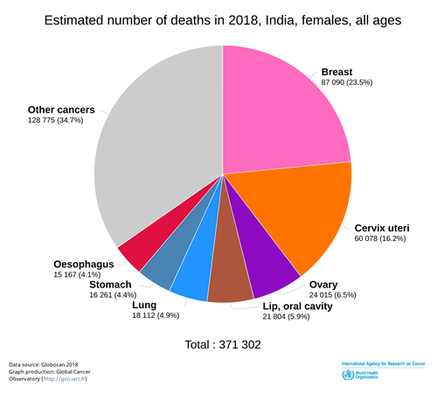
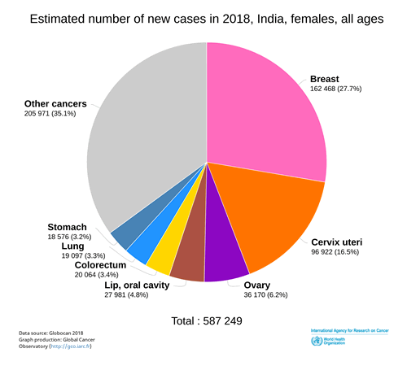
In women in India, for the year 2018:
61,264 out of an estimated total 186,965 cases of cancer, were due to breast cancer, for the age group of 25 to 49 years.
Breast Cancer accounted for 32.8% of all cancer cases in women in India for that year (2018), for that age group. Roughly, that translates into one third of all cases of cancer in the age group of 25 to 49 years, being due to breast cancer.
21,892 women died of breast cancer for this age group
Cancer of the Cervix and Cancer of the Ovary are the second and third most common cancers in this age group. These three account for more than 60 percent cancers in women in 25 to 49 age group, in India.
61,264 x 100 / 162468 = 37.70%. So, the breast cancers in 25 to 49 years age group accounted for 37.70% of all breast cancers in women in India, for the year 2018.

Slide 3
Understanding Breast Cancer
Risk Factors
Symptoms and Diagnosis
Treatment Options
Genetic mutations and family history are common risk factors for breast cancer.
Early detection methods include mammograms and self-examinations.
Treatment may involve surgery, chemotherapy, radiation, or hormone therapy.

Slide 4
Data Collection and Preprocessing
Gathering Relevant Data
Data Cleaning
Feature Engineering
Data on patient demographics, tumor characteristics, and treatment outcomes is collected.
Data gathered from UCI machine learning repository
Data is processed to remove errors, inconsistencies, and missing values.
New features are created based on the available data to improve model performance.

Slide 5
Machine Learning Model Development
Algorithm Selection
Model Training
Hyperparameter Tuning
Suitable algorithms such as logistic regression, decision trees, or neural networks are chosen.
The model is trained on the dataset to learn and make predictions.
Fine-tuning of model parameters is done to optimize performance.

Slide 6
Model Evaluation and Validation
Cross-Validation
Performance Metrics
Overfitting and Underfitting
Validation technique used to assess how the results will generalize to an independent dataset.
Realtime reports of patients is accessed from AIIMS and ICMR to prove efficiency of model and deploy it
Metrics such as accuracy, precision, recall, and F1 score are used to evaluate the model.
Challenges of overfitting and underfitting are addressed to ensure model generalizability.

Slide 7
Clinical Impact and Future Steps
Application in Clinical Practice
Research and Innovations
Challenges and Opportunities
The model's potential role in aiding diagnosis and treatment decisions in healthcare settings.
Further research in areas like personalized medicine and early detection strategies.
Anticipated challenges and opportunities in implementing machine learning in healthcare.

Slide 8
Conclusion
Key Findings
Future Prospects
Impact on Healthcare
Summarization of the key insights and results from the breast cancer machine learning project.
Potential applications and further advancements in leveraging machine learning for healthcare.
The influence of machine learning in enhancing breast cancer diagnosis and care.

